Slide 1
Tidying Data
Get over here, data
Notes:
https://www.hcbravo.org/IntroDataSci/bookdown-notes/tidying-data.html

Slide 2
Workshop Objective
Recap on previous topics
Understanding why we clean data
Understand some methods of data cleaning incorporating all the methods learnt in the previous workshops
Write a very simple function

Slide 3
Some Questions to think about
1. How to properly install R, Rstudio, and libraries
2. How to get packages from Bioconductor
3. How to import data into the R environment
4. What’s data type, what's data structure
5. How to filter data (rows) using indices and dplyr

Slide 4
Some Questions to think about
6. How to subset data (columns) using indices and dplyr
7. How to draw a plot in baseR and using gglot2?
8. What plot to draw for what data？
9. When do you have too little data and when do you have too much data on a single plot
10. When do you need to use loops?

Slide 5
Some Questions to think about
11. When do you need pipes?
12. When someone give you a dataset, do you know how to get a visualization out？ and what would be a correct graph to give??

Slide 6
Data Import
import.csv(“File directory.csv”)
readr(“File directory.csv”)
readxl(“File directory.xls”)
BiocManager::install("airway")
library(Airway)

Slide 7
Data Cleaning and Tidying - Why?
“Happy families are all alike; every unhappy family is unhappy in its own way.”
–– Leo Tolstoy
“Tidy datasets are all alike, but every messy dataset is messy in its own way.”
–– Hadley Wickham

Slide 8
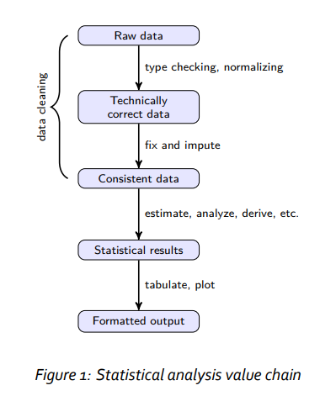
Statistical Analysis Value Chain
Notes:
https://cran.r-project.org/doc/contrib/de_Jonge+van_der_Loo-Introduction_to_data_cleaning_with_R.pdf

Slide 9
What you mean a tidy data
Each attribute (or variable) forms a column
Each entity (or observation) forms a row
Each type of entity (observational unit) forms a table

Slide 10
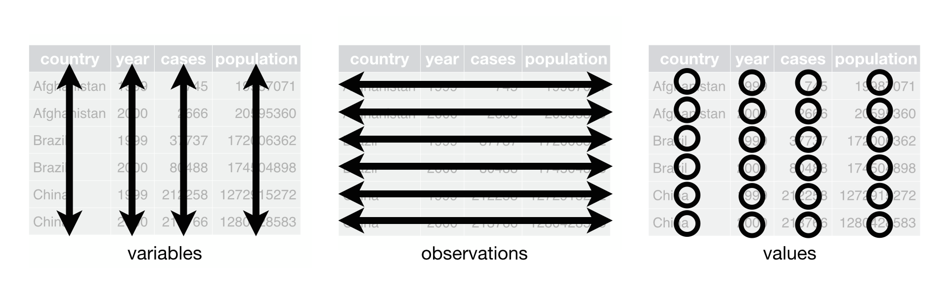
What you mean a tidy data

Slide 11
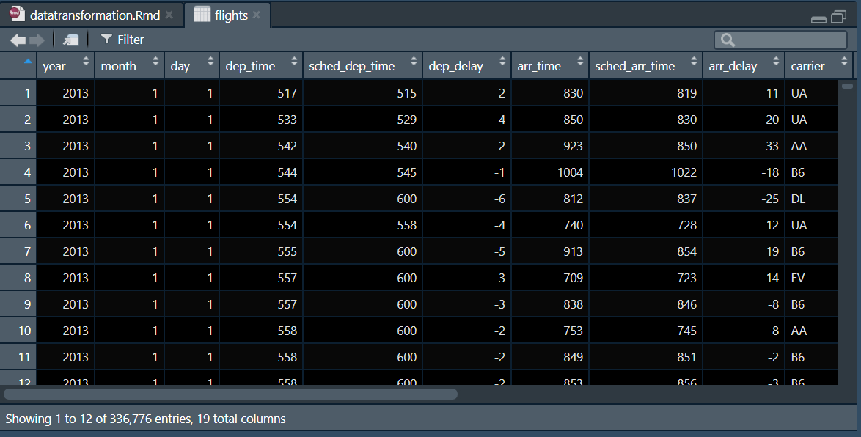

Slide 12
Source of Non Tidy Data?
Handle Large Volumes of Data at High Speed with a Scale-Out Architecture
Store Unstructured, Semi-Structured, or Structured Data
Enable Easy Updates to Schema and Fields
Developer-Friendly
Notes:
https://simplystatistics.org/2016/02/17/non-tidy-data/
https://www.mongodb.com/nosql-explained/advantages

Slide 13
Common problems in messy data
Column headers are values, not variable names (gather)
Multiple variables stored in one column (split)
Variables stored in both rows and column (rotate)
Multiple types of observational units are stored in the same table (normalize)
Single observational unit stored in multiple tables (join)
Many more………..
Notes:
https://simplystatistics.org/2016/02/17/non-tidy-data/
https://www.mongodb.com/nosql-explained/advantages

Slide 14
Tidying Data - useful Tools
Joining Columns
Separating Columns
Converting Long format to wide format (vice versa)
Coercing data (character to number, vice versa)
Character date to POSIXt data

Slide 15
Long to wide data (reshape2-melt)
An Example on wide format data
## ozone wind temp
## 1 23.61538 11.622581 65.54839
## 2 29.44444 10.266667 79.10000
## 3 59.11538 8.941935 83.90323
## 4 59.96154 8.793548 83.96774

Slide 16
Long to wide data (reshape2-melt)
An example on long format data (## No id variables; using all as measure variables)
## variable value
## 1 ozone 23.615385
## 2 ozone 29.444444
## 3 ozone 59.115385
## 4 ozone 59.961538
## 5 wind 11.622581
….(cont.)

Slide 17
Missing values - (complete.cases & imputation)
library(imputeTS)
x <- imputeTS::na.locf(x, option = "locf", na.remaining = "rev")
x <- imputeTS::na.locf(x, option = "nocb", na.remaining = "rev")
#################
data[complete.cases(data), ] # Keep only the complete rows
data_complete <- data[complete.cases(data), ] # Store the complete cases subset in a new data frame

Slide 18
Functions
In programming, you use functions to incorporate sets of instructions that you want to use repeatedly or that, because of their complexity, are better self-contained in a sub program and called when needed.
A function is a piece of code written to carry out a specified task; it can or can not accept arguments or parameters and it can or can not return one or more values.
Notes:
https://intro2r.com/using-functions-in-r.html
https://www.datacamp.com/community/tutorials/functions-in-r-a-tutorial

Slide 19
Function Syntax
function.name <- function(arguments)
{
computations on the arguments
some other code
}

Slide 20
Functions Example 1
> pow <- function(x, y) {
# function to print x raised to the power y
result <- x^y
print(paste(x,"raised to the power", y, "is", result))
}
> pow(4,3) ##calculate 2^3
2 raise to the power of 3 is 8

Slide 21
Functions Example 1
Named Arguments
> pow(x = 8, y = 2)
64
> pow(y = 8, x = 2)
256

Slide 22
Example 2 - Default arguments
> pow <- function(x, y = 2) {
# function to print x raised to the power y
result <- x^y
print(paste(x,"raised to the power", y, "is", result))
}
> pow(5)
25

Slide 23
Example 2 - Default arguments
> pow <- function(x, y = 2) {
# function to print x raised to the power y
result <- x^y
print(paste(x,"raised to the power", y, "is", result))
}
> pow(5,3) ## change y to 3
125

Slide 24
Why function in Data Cleaning?

Slide 25
Let’s head to R

